Slide 1
Intelligence vs Artificial Intelligence
Intelligence is a property/ability attributed to people, such as to know, to think, to talk, to learn, to understand.
Intelligence = Knowledge + ability to perceive, feel, comprehend, process, communicate, judge, learn.
Artificial Intelligence is an interdisciplinary field aiming at developing techniques and tools for solving problems that people at good at.

Slide 2
Definition of AI
Existing definitions advocate everything from replicating human intelligence to simply solving knowledge-intensive tasks.
Examples:
“Artificial Intelligence is the design, study and construction of computer programs that behave intelligently.” -- Tom Dean.
AI is defined as an experimental discipline utilizing the ideas and the methods of computation.

Slide 3
What Does AI Really Do?
Scientific goal: understand the mechanism behind human intelligence.
Engineering goal: develop concepts and tools for building intelligent agents capable of solving real world problems.
Examples:
Knowledge-based systems: capture expert knowledge and apply them to solve problems in a limited domain(Expert Systems- DENDRAL: Expert system used for chemical analysis to predict molecular structure)
Common sense reasoning systems: capture and process knowledge that people commonly hold which is not explicitly communicated.
Learning systems: have the ability to expend their knowledge based on the accumulated experience.
Natural language understanding systems. Intelligent robots, Speech and vision recognition systems.
Game playing- the game-playing AI created by Google sibling DeepMind, has beaten the world's best chess-playing computer program, having taught itself how to play in under four hours. ... It took just four hours to learn the rules to chess before beating the world champion chess program,

Slide 4
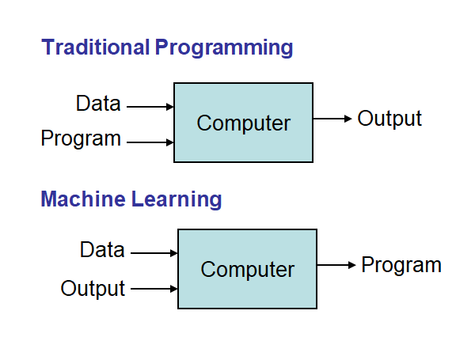
Definitions of Machine Learning
Machine learning is a branch of artificial intelligence based on the idea that systems can learn from data, identify patterns and make decisions with minimal human intervention.
A computer program that can learn from experience E with respect to some class of tasks T and performance measure P, so that its performance at tasks in T, as measured by P, improves with experience E.

Slide 5
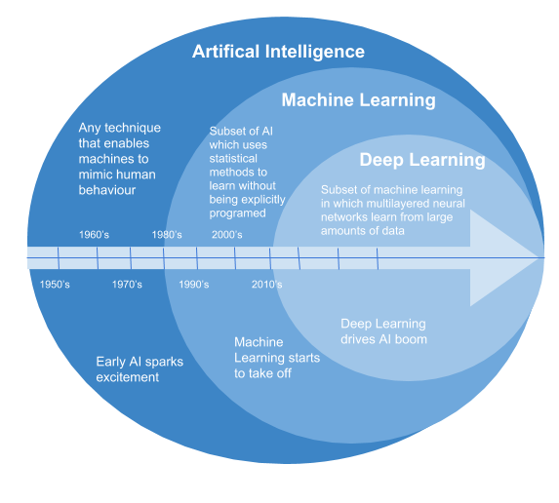
Machine Learning
`

Slide 6
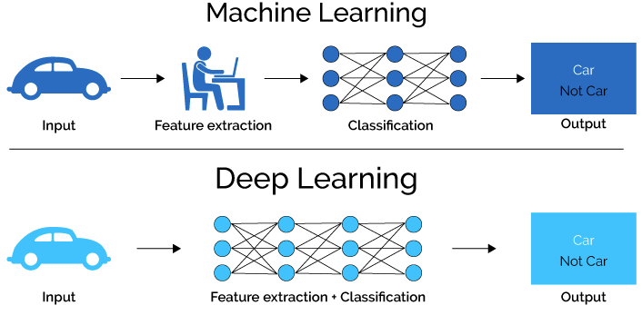
Machine Learning Vs Deep Learning

Slide 7
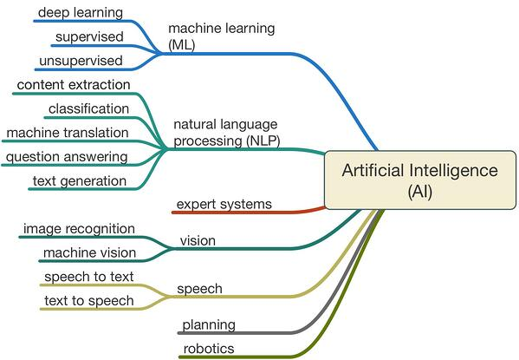

Slide 8
Machine Learning Algorithms
Tens of thousands of machine learning algorithms, hundreds new every year
Types of Machine Learning Algorithms:
Supervised (inductive) learning Training data includes desired outputs
Unsupervised learning Training data does not include desired outputs
Semi-supervised learning Training data includes a few desired outputs(few labelled and few unlabeled)
Reinforcement learning Rewards from sequence of actions(no supervisor and feedback delayed, not instantaneously)

Slide 9
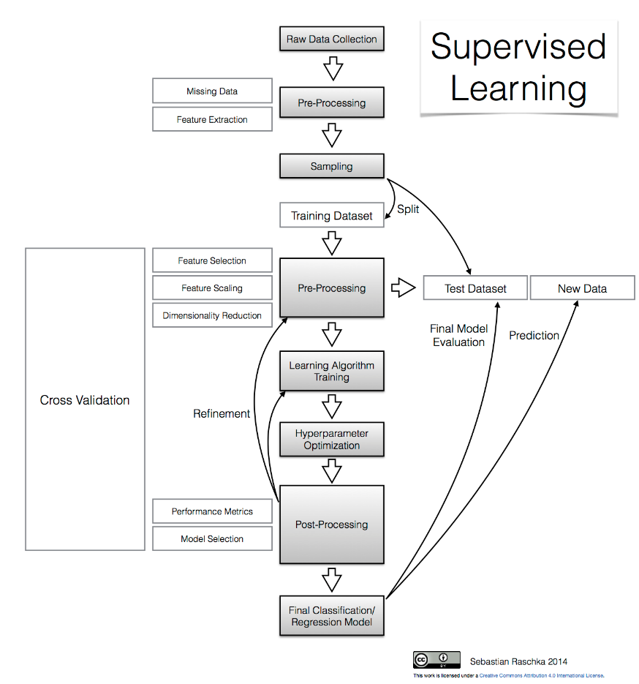
Classification

Slide 10
Components of a ML Algorithm
Model Structure (Representation) Linear Models
Decision trees
Ensembles of models
Instance based methods
Neural networks
Support vector machines
Graphical models (Bayes/Markov nets)
Etc.
Loss Function (Evaluation)
Accuracy
Precision and recall
Squared error
Likelihood
Posterior probability
Cost / Utility
Margin
Entropy
K-L divergence
Fitting Parameters (Optimization)
Greedy search
Gradient Descent
Linear Programming
Many variations

Slide 11
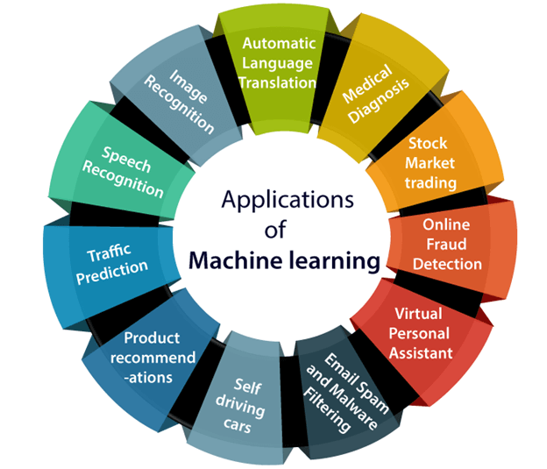
Successes of AI and Machine learning
Health Care
Web search
Finance / Trading
Marketing
Fraud and Security
E-commerce
Robotics
Social networks
Recommendations
NLP / Digital Assistants
‘Self Driving’ Cars
[Your favorite area]

Slide 12
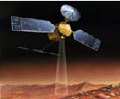
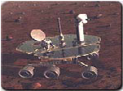
AI Applications
Autonomous Planning & Scheduling:
Autonomous rovers.

Slide 13
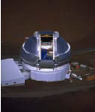
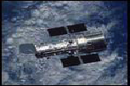
AI Applications
Autonomous Planning & Scheduling:
Telescope scheduling

Slide 14

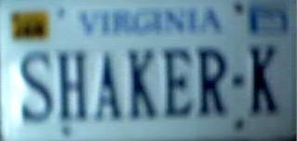
AI Applications
Pattern recognition
Image analysis and enhancement

Slide 15


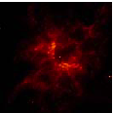
AI Applications
Autonomous Planning & Scheduling:
Analysis of data:

Slide 16

AI Applications
Transportation:
Autonomous vehicle control

Slide 17

AI Applications
Transportation:
Pedestrian detection:

Slide 18
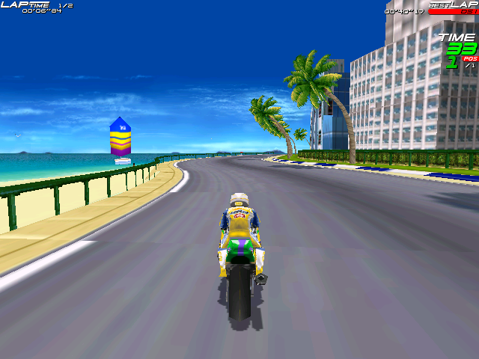
AI Applications
Games:

Slide 19
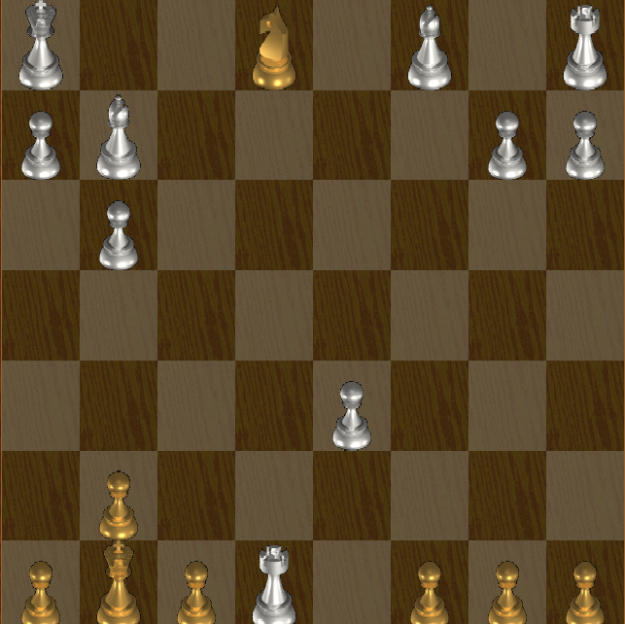
AI Applications
Games:

Slide 20
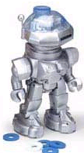

AI Applications
Robotic toys:

Slide 21
Medical image segmentation

